Slide 1

Breast cancer research and diagnosis
Date- 11/28/2023
Uttarina Roy
uttarina.roy@pace.edu
Practical Data science CS-667
MS in Data science

Slide 2

A g e n d a
Summary
Project plan
Exploratory data analysis

Slide 3

INTRODUCTION
Breast cancer is a major health concern worldwide, and early detection is essential for improving survival rates and patient outcomes. In recent years, machine learning has emerged as a promising tool for enhancing cancer detection and diagnosis. Today, we will focus on the application of Random Forest Classifier, a powerful and accurate ensemble learning technique, in the early detection of breast cancer.

Slide 4

Dataset Overview
The scikit-learn Breast Cancer dataset, derived from the Breast Cancer Wisconsin (Diagnostic) dataset, contains 569 breast masses with 30 real-valued features. These cell nuclei features, computed from digitised Fine Needle Aspirate (FNA) images, include radius, texture, perimeter, area, smoothness, compactness, concavity, concave points, symmetry, and fractal dimension. The dataset has 30 features with mean, standard error, and "worst" values. Malignant breast masses are 0 and benign ones are 1.

Slide 5

Pair plot
A grid of scatter plots coloured by the target variable shows pairwise relationships between variables in a dataset. Pair plots show feature pair-target variable relationships, revealing breast cancer dataset patterns, trends, and outliers. They identify feature interactions, data structure, and key features. Pair plots are complex. Seaborn's sns.pairplot() function creates pair plots with 'target' hue for class separability.

Slide 6
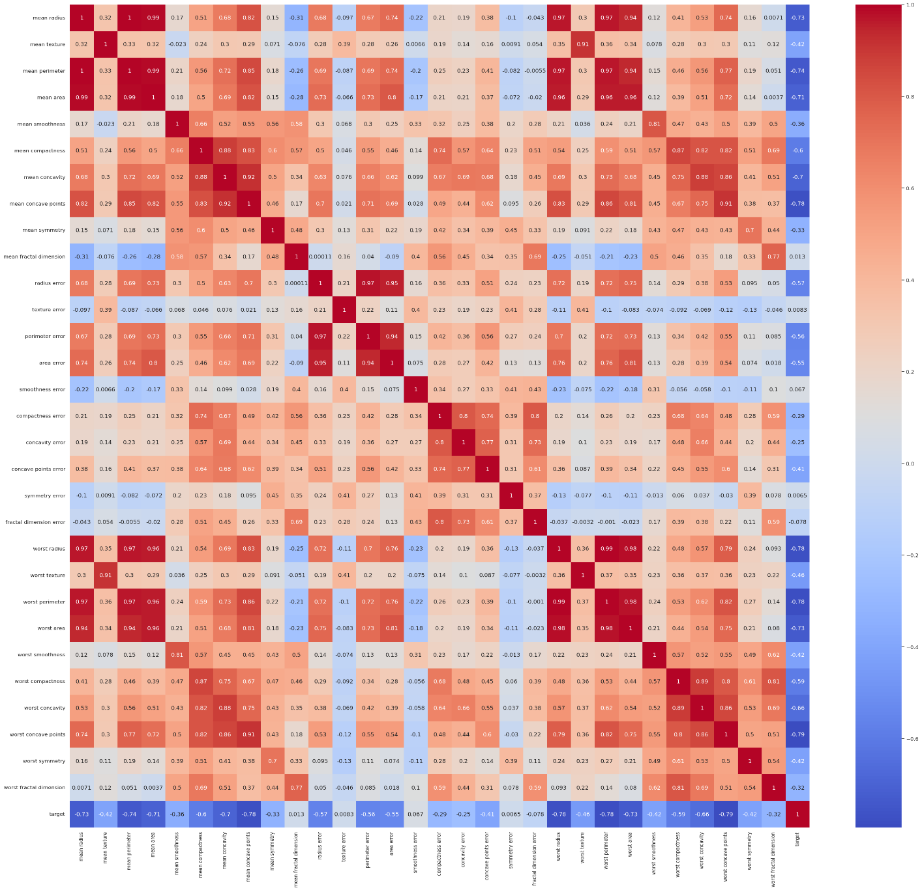
Correlation Heatmap
A correlation heatmap uses a colour gradient to show correlation coefficients between variables, making complex data patterns easier to understand. The heatmap shows relationships between the 30 breast cancer dataset features, helping understand data structure and select important features. Heatmap analysis reveals multicollinearity issues that can be fixed with dimensionality reduction or feature selection to improve machine learning model performance.

Slide 7
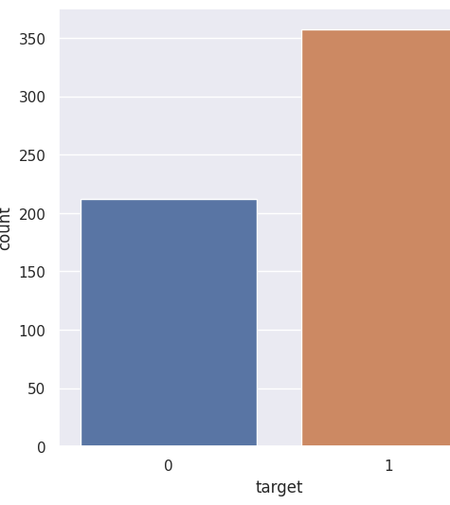
Count Plot
Vertical bars represent categorical variable frequency distributions in count plots. For the breast cancer dataset, sns.countplot plots the target variable as 0 for malignant cases and 1 for benign cases. The dataset's malignant-to-benign ratio is plotted. In imbalanced datasets, models may favour the majority class. The count plot guides machine learning model evaluation metrics, modelling methods, and data preprocessing.

Slide 8
Model Implementation and Evaluation
Import necessary libraries (pandas, numpy, scikit-learn, seaborn)
Load dataset, convert to DataFrame, separate features and target
Split data: 80% training, 20% testing
Apply feature scaling with StandardScaler (optional for Random Forest)
Train Random Forest Classifier on training data
Make predictions on test data
Evaluate performance using precision, recall, F1-score, confusion matrix, and accuracy score
Adjust model as needed (hyperparameter tuning, feature selection, data preprocessing)

Slide 9
Results
 | Precision | Recall | F1-Score | Support
Class 0 (Malignant) | 0.98 | 0.93 | 0.95 | 43
Class 1 (Benign) | 0.96 | 0.99 | 0.97 | 71
Accuracy |  |  | 0.96 | 114
Macro Avg | 0.97 | 0.96 | 0.96 | 114
Weighted Avg | 0.97 | 0.96 | 0.96 | 114
The Random Forest Classifier model achieved an overall accuracy of 96.49%. It demonstrated a 97.56% precision and a 94.02% recall for class 0 (Malignant), while achieving a 95.89% precision and a 98.59% recall for class 1 (Benign). The F1-scores for malignant and benign classes were 95.24 and 97.22, respectively. These results highlight the model's strong performance across both classes, with weighted averages and global averages supporting its effectiveness.

Slide 10
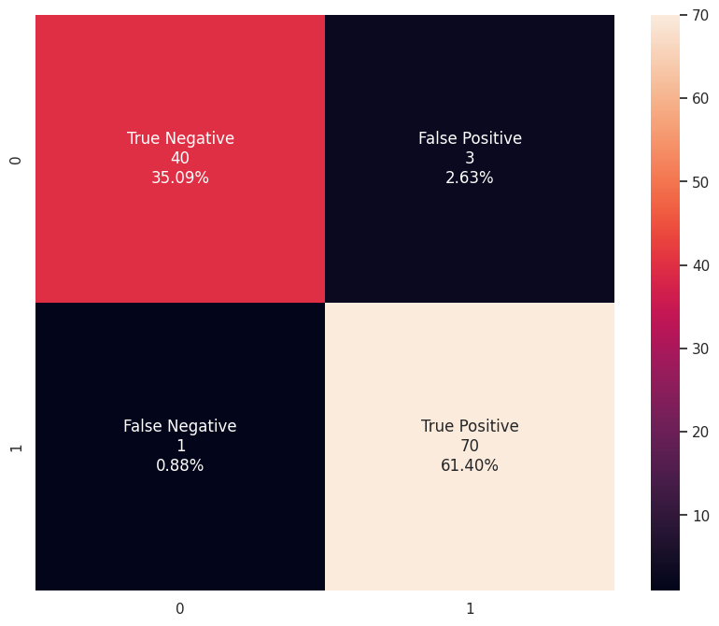
Confusion Matrix
Top-left (40): True Negatives (TN) - The number of instances correctly predicted as negative (malignant).
Top-right (3): False Positives (FP) - The number of instances falsely predicted as positive (benign) when they are actually negative (malignant).
Bottom-left (1): False Negatives (FN) - The number of instances falsely predicted as negative (malignant) when they are actually positive (benign).
Bottom-right (70): True Positives (TP) - The number of instances correctly predicted as positive (benign).

Slide 11

Random Forest Classifier (RFC)
Random Forest Classifier is an ensemble learning method combining multiple decision trees to enhance performance and generalization. It trains on bootstrap samples and employs majority voting for predictions. This approach reduces overfitting and increases robustness. Performance is assessed using accuracy, precision, recall, and F1-score, with hyperparameter tuning for optimization.

Slide 13

5. Conclusion
Neural Networks, Random Forest Classifier, and Logistic Regression can be used to diagnose breast cancer, according to this study. Data preprocessing, visualisation, and model evaluation reveal feature relationships and classification performance.
Correlation Heatmap, Pair Plot, and Count Plot help understand data structure, identify multicollinearity issues, and guide feature selection and model optimisation.
For best performance, machine learning algorithms, hyperparameters, and class imbalance must be chosen. This study shows how Python and machine learning improve medical research and patient outcomes.

